Slide 1
AWS Architecture Shopping
Release 2023.12.20
Team members:
Axel Alberto
Meron Asfaha
Mikal Gebremedhin
Temesgen Boja Dessalegn
Sardorbek Abdupattaev

Slide 2
Introduction
Overview of the AWS architecture for shopping application, focusing on key components and their integration.

Slide 3
Beanstalk
Easy Deployment: Provide .jar file, Beanstalk automatically handles the deployment details.
Auto-Scaling: It can automatically scale your application up and down based on the application's specific needs.
Support for Multiple Programming Languages: Java, .NET, PHP, Node.js, Python, Ruby, Go, and Docker
Integration with Other AWS Services: It integrates well with other services Amazon Virtual Private Cloud (VPC).
Environment Management:
Customization: You can use configuration files to customize the AWS resources EC2 instances, and you can SSH into these instances for debugging purposes.

Slide 4
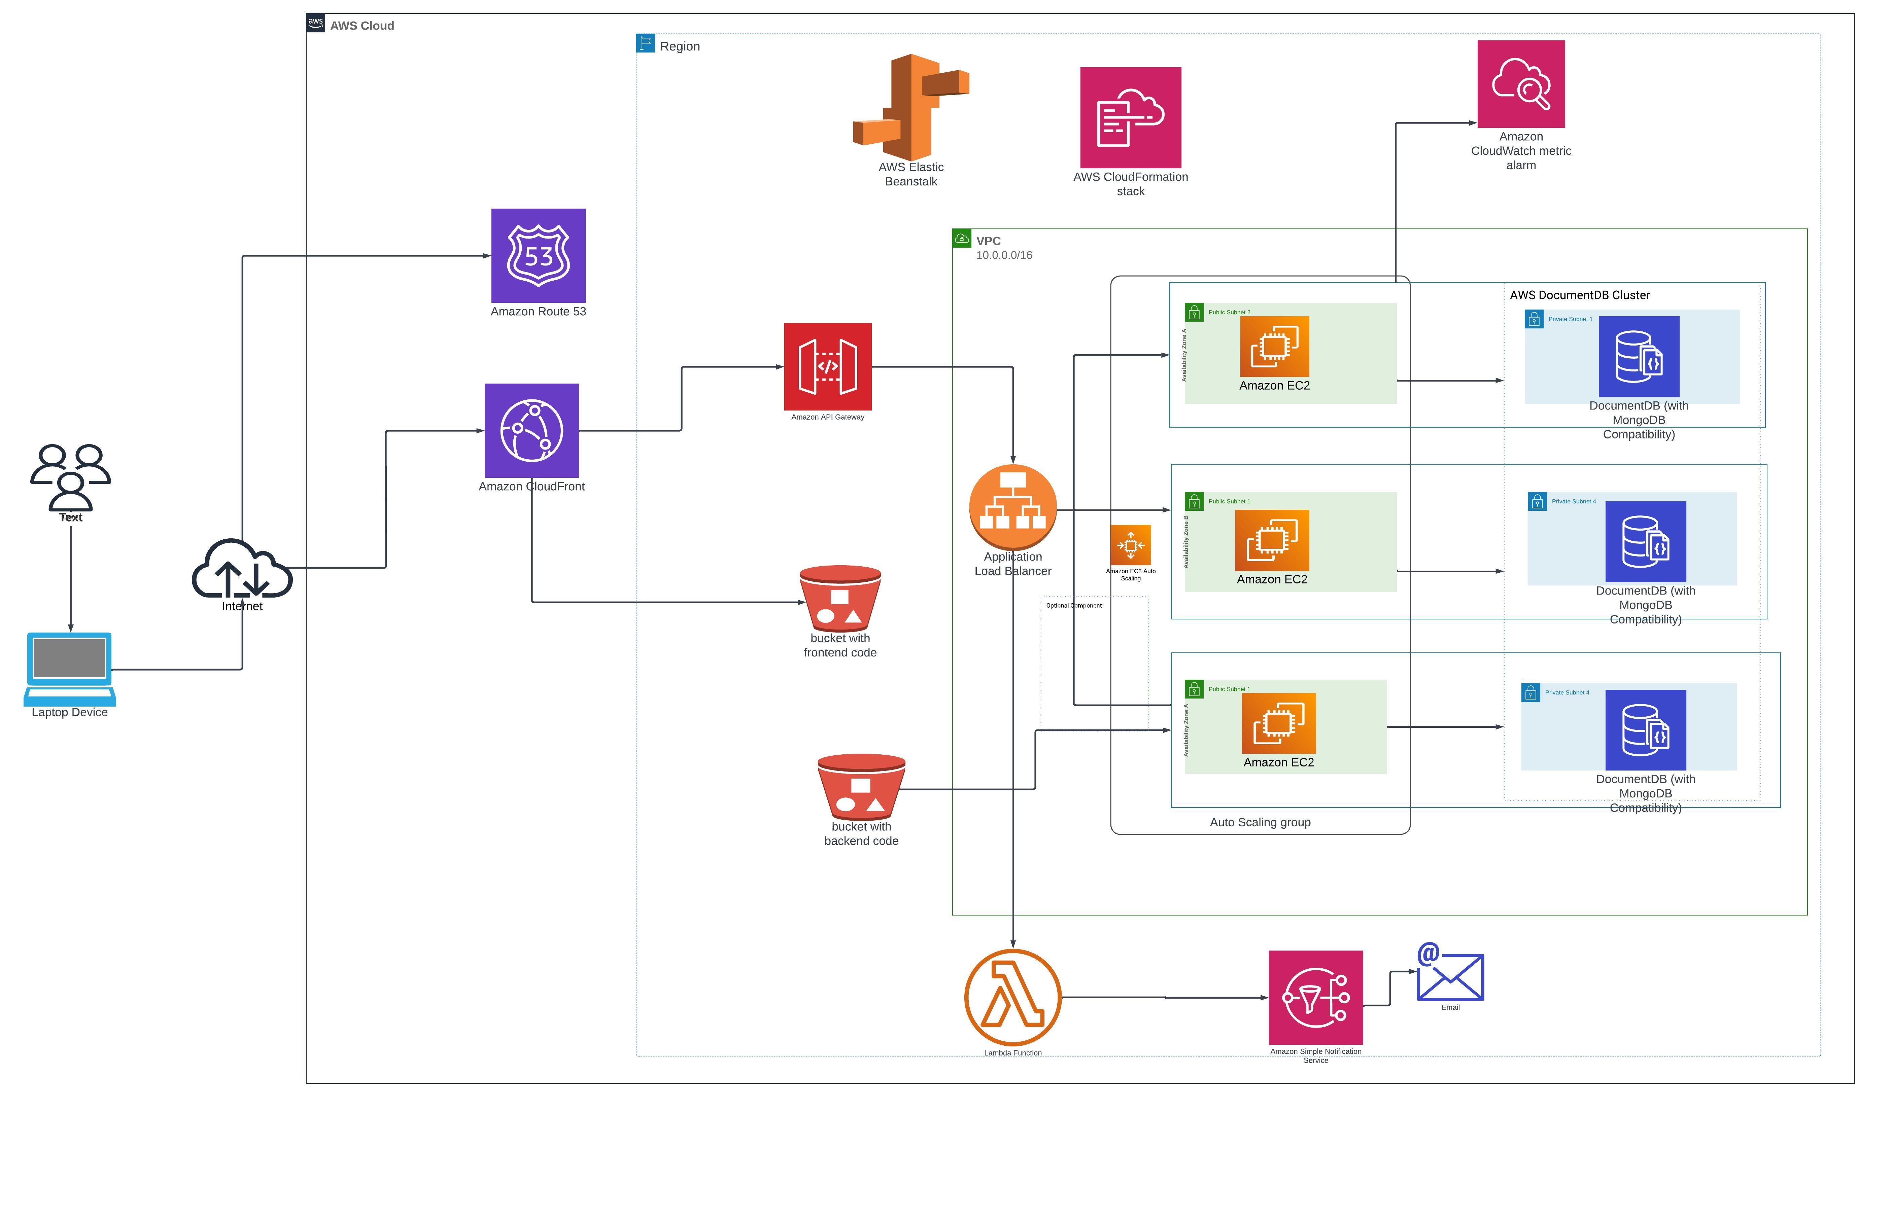
Architecture

Slide 5
S3 Integration
Detailing S3's role in the architecture and its interaction with other AWS services.

Slide 6
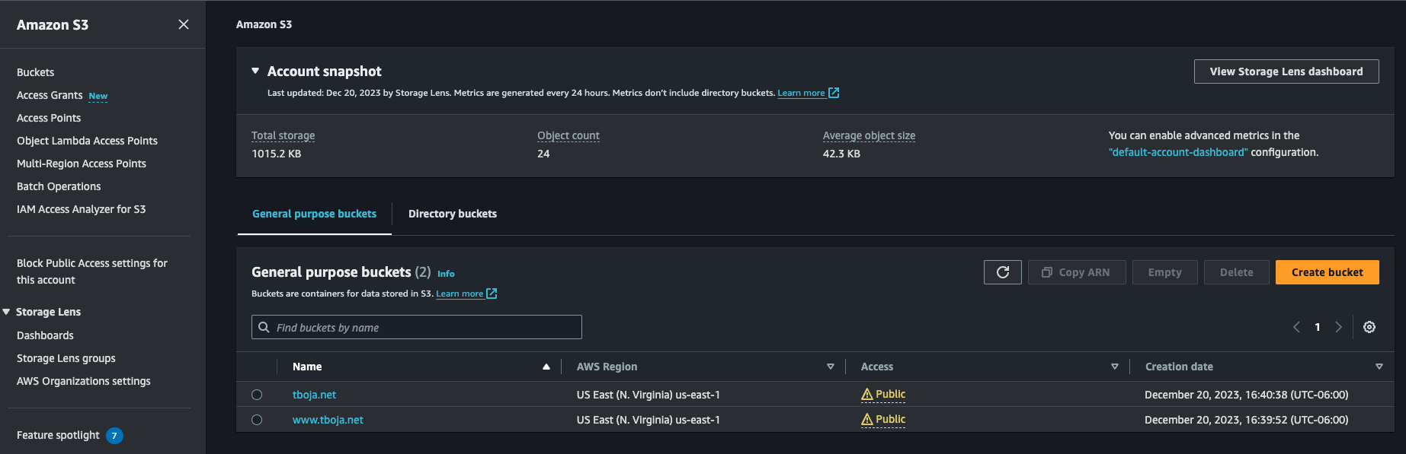
S3 Integration

Slide 7
CloudFront and Route53
Explaining the role of CloudFront in content delivery and Route53 in DNS services.

Slide 8
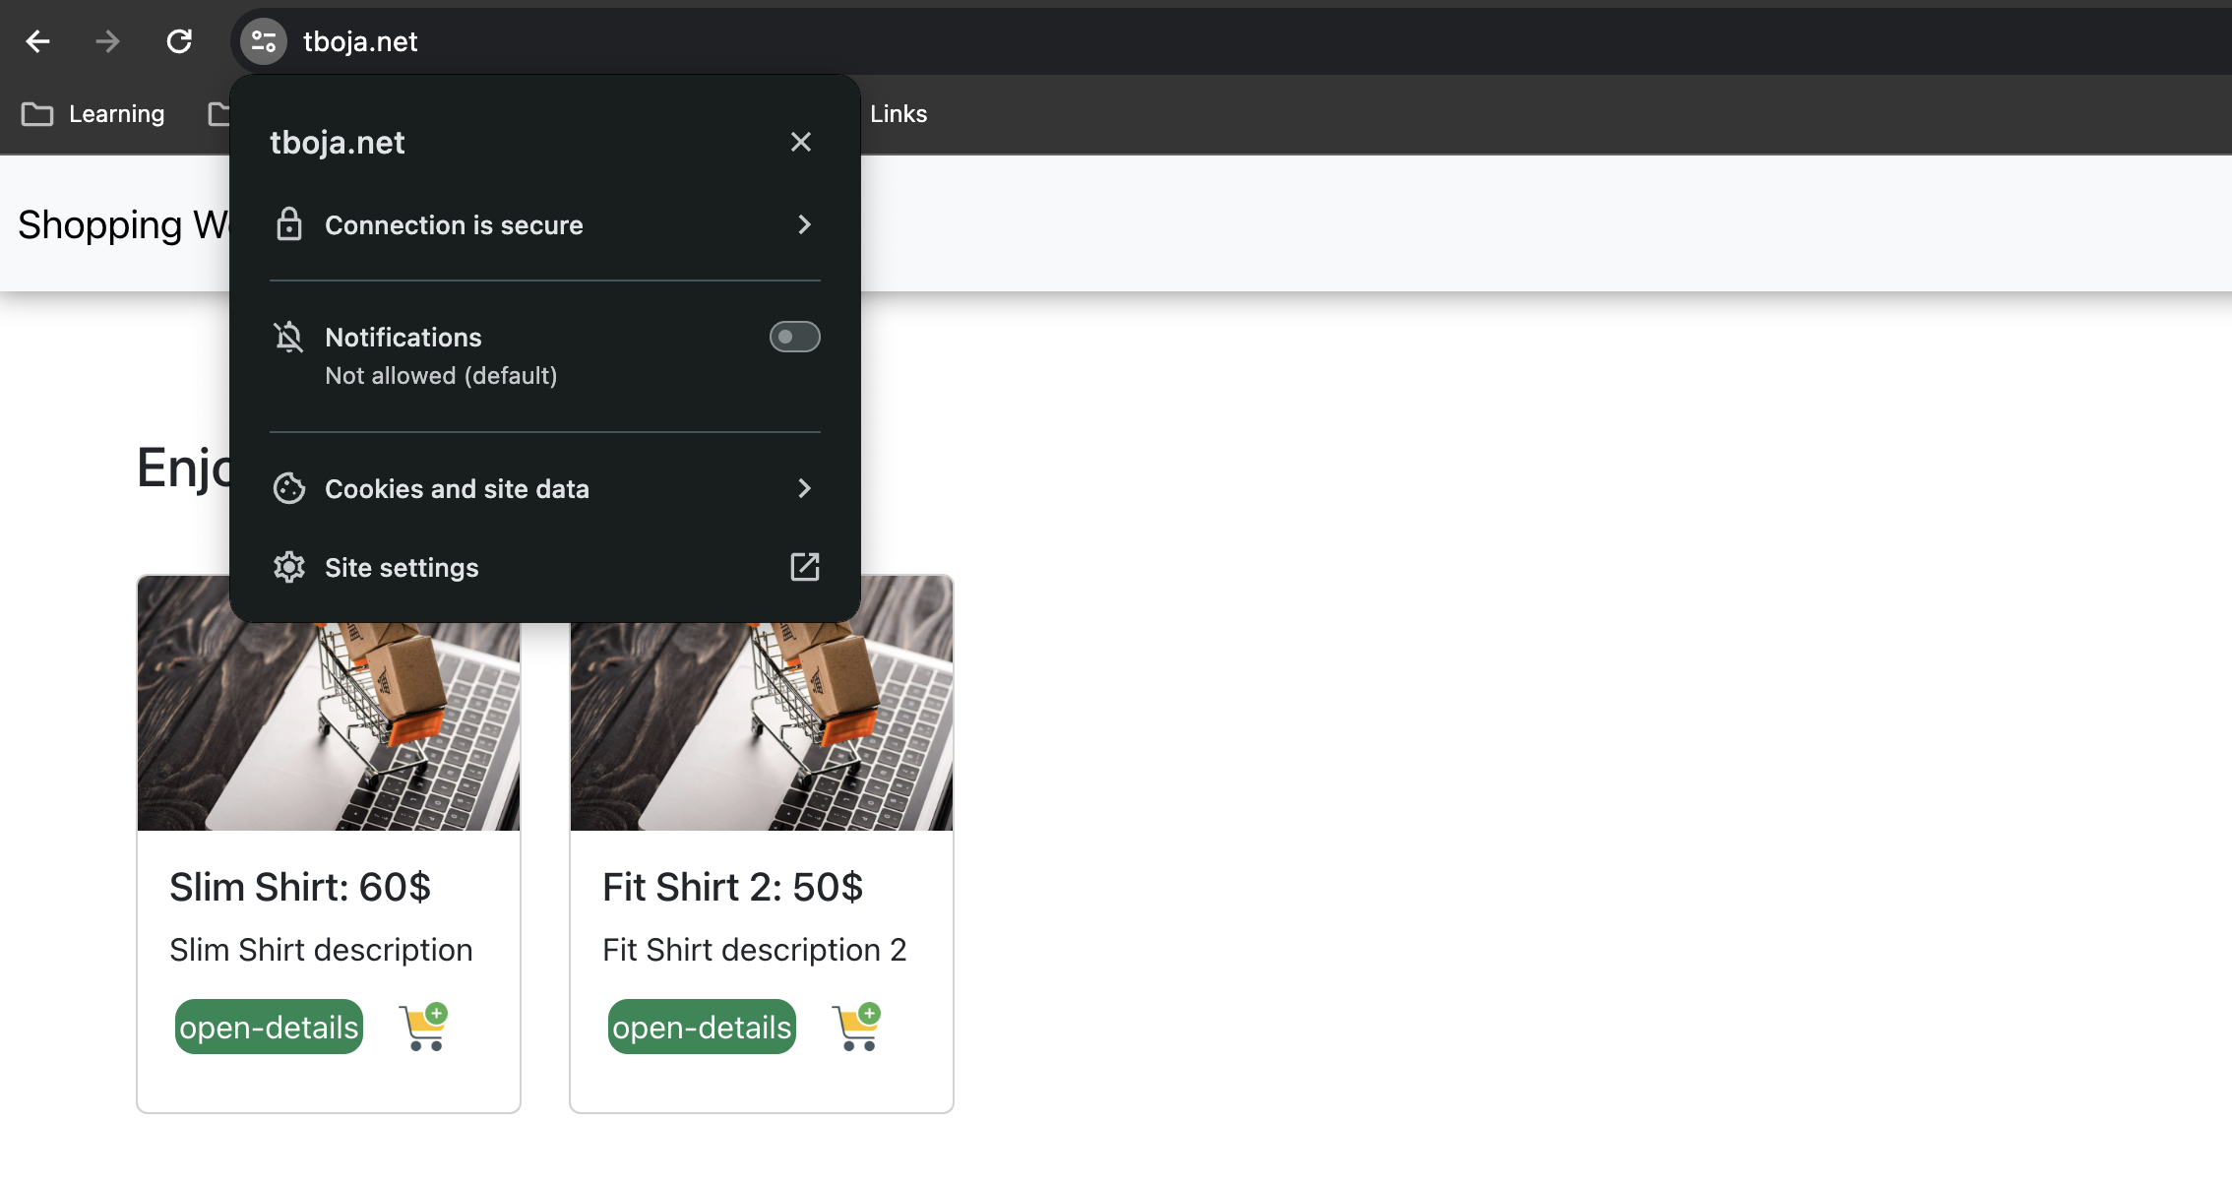
CloudFront and Route53

Slide 9
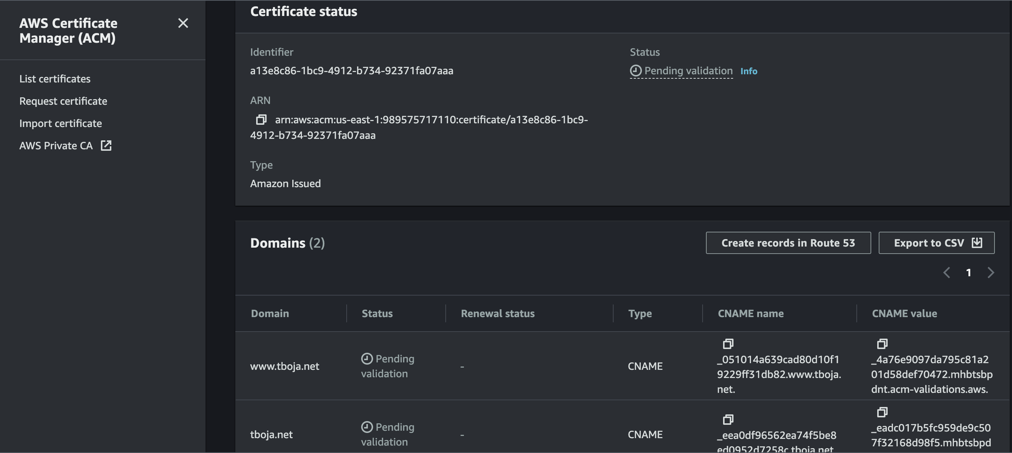
CloudFront and Route53

Slide 10
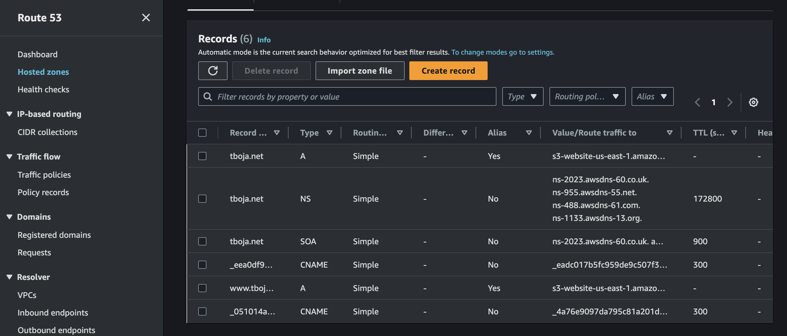
CloudFront and Route53

Slide 11
Lambda & SNS
Email Integration through Lambda

Slide 12
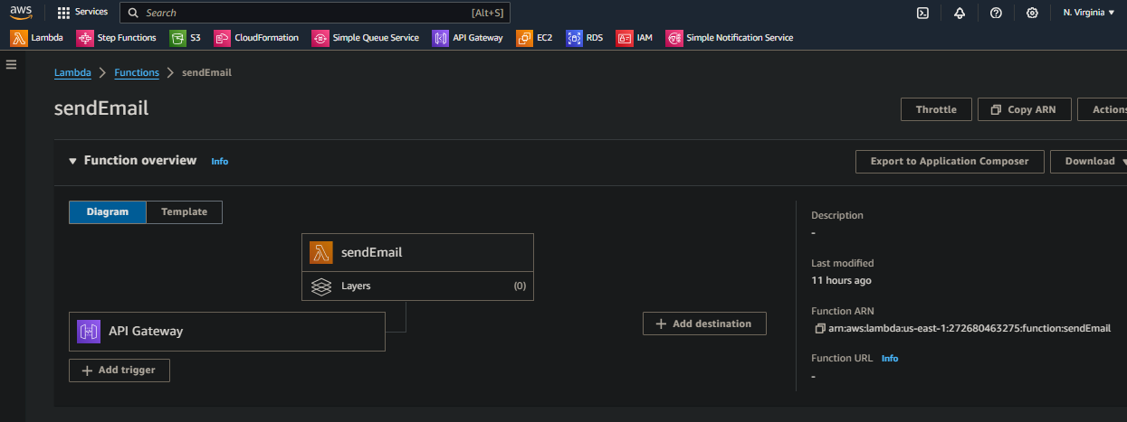
Lambda function

Slide 13
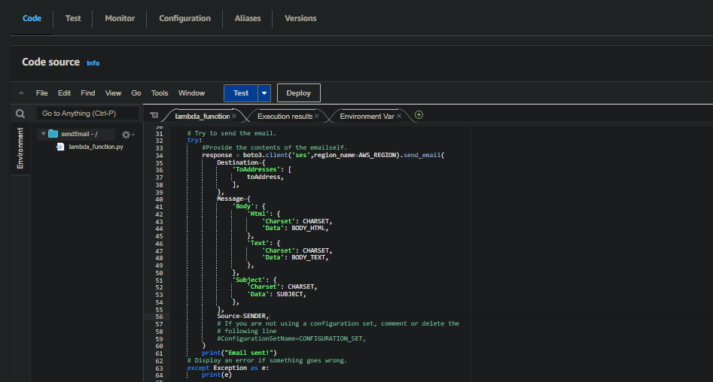
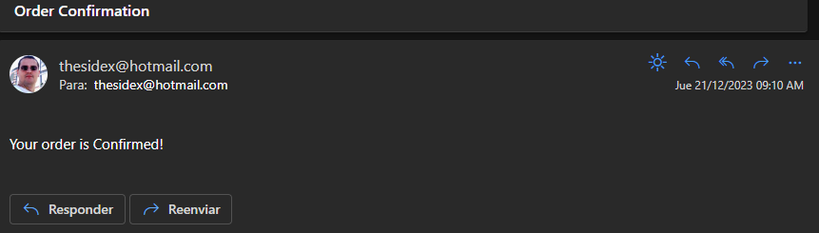
Lambda function

Slide 14
Api Gateway, Elastic Beanstalk and Spring Application
The functionality of API Gateway and its communication with the Elastic Beanstalk environment.

Slide 15
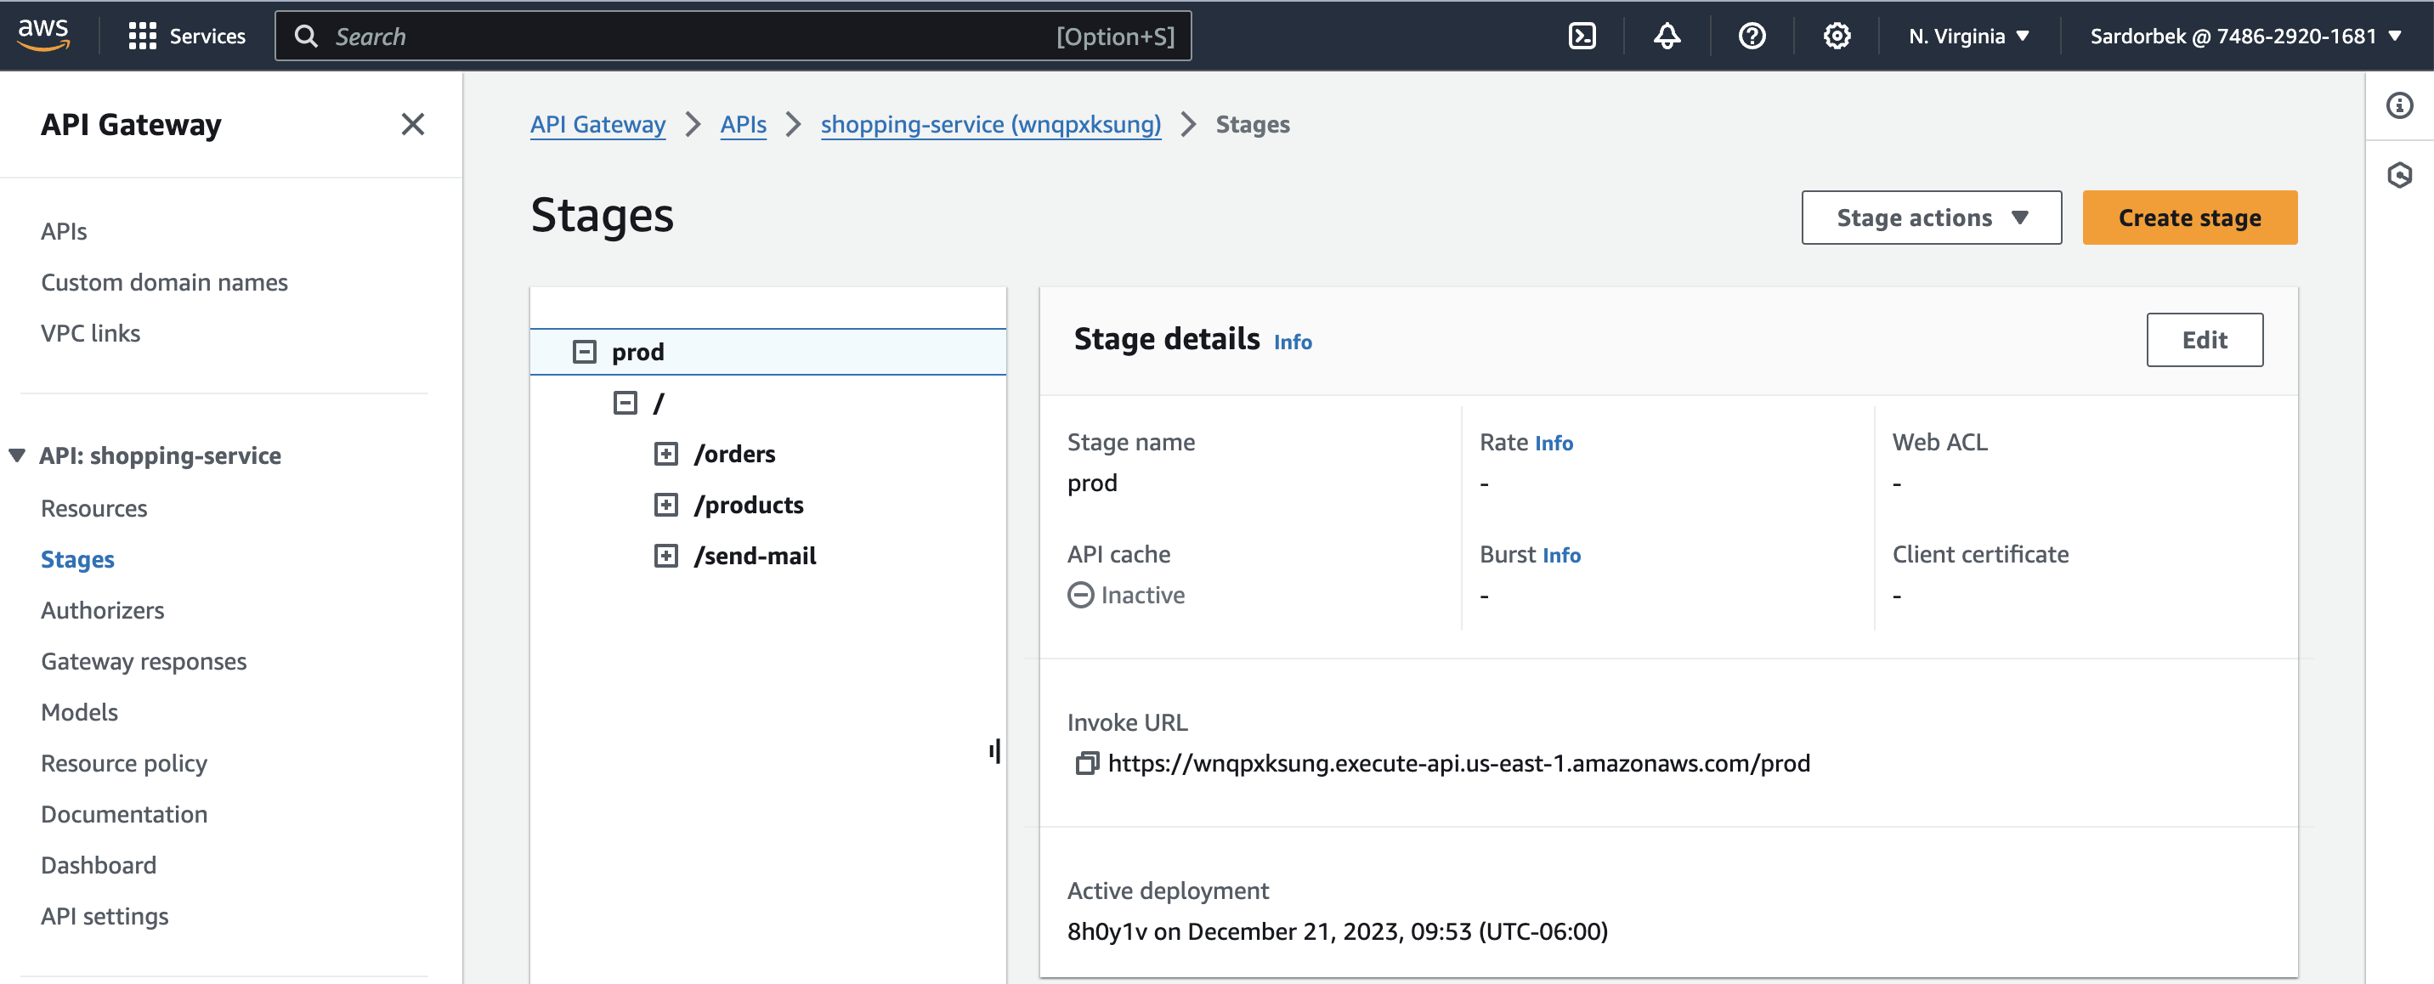
Api Gateway

Slide 16
Used AWS Services
CloudFront & Route53
Lambda
AWS DocumentDB
SNS
S3
Api Gateway
Elastic BeanStalk
Load Balancing
EC2
Auto Scaling Group
CloudFormation
CloudWatch
SES

Slide 17
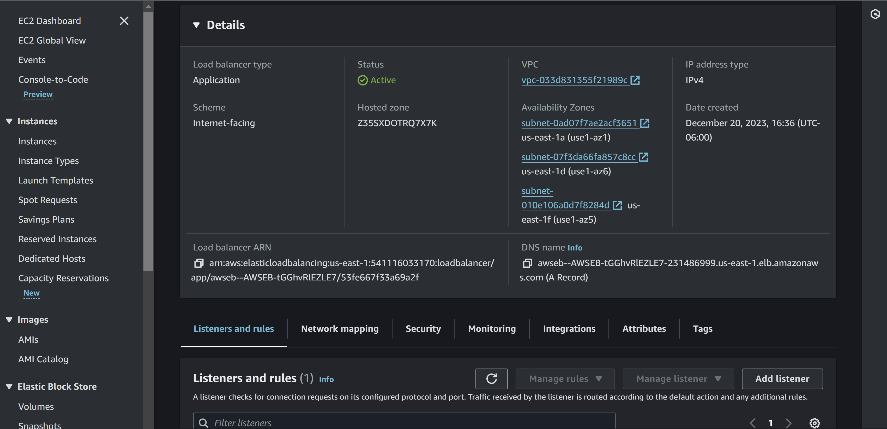
Beanstalk, Load Balancer

Slide 18
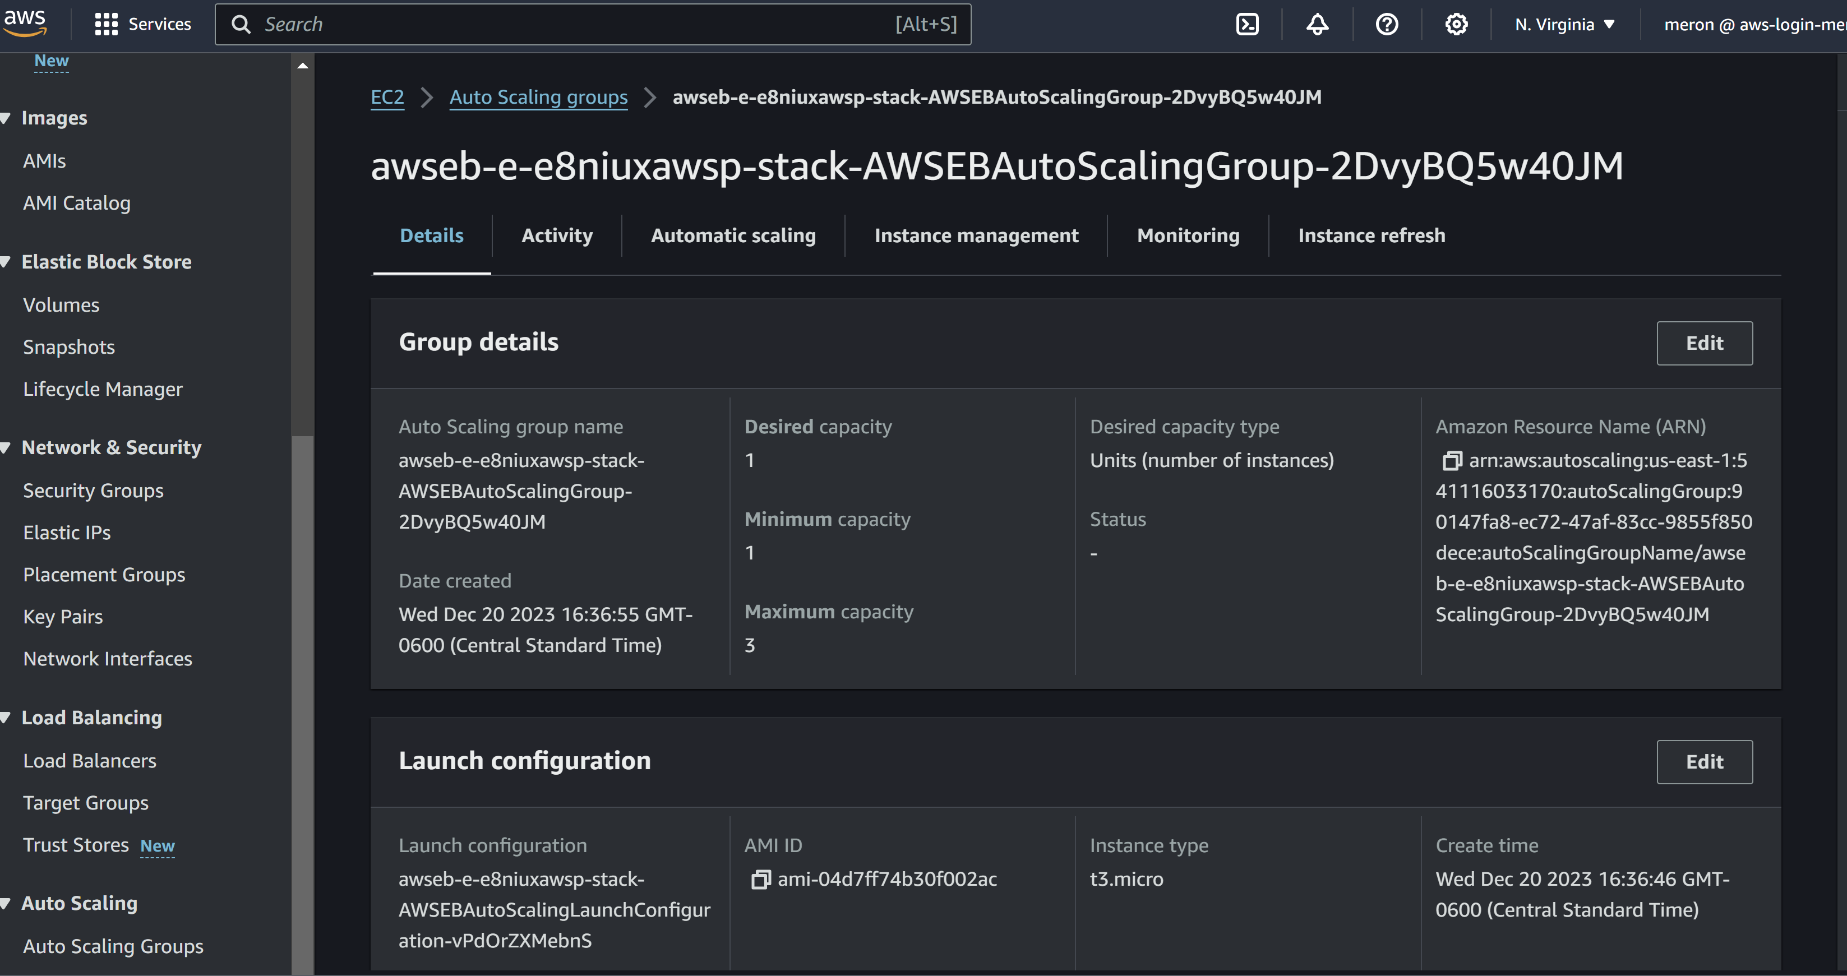
Beanstalk, Auto Scaling Group

Slide 19
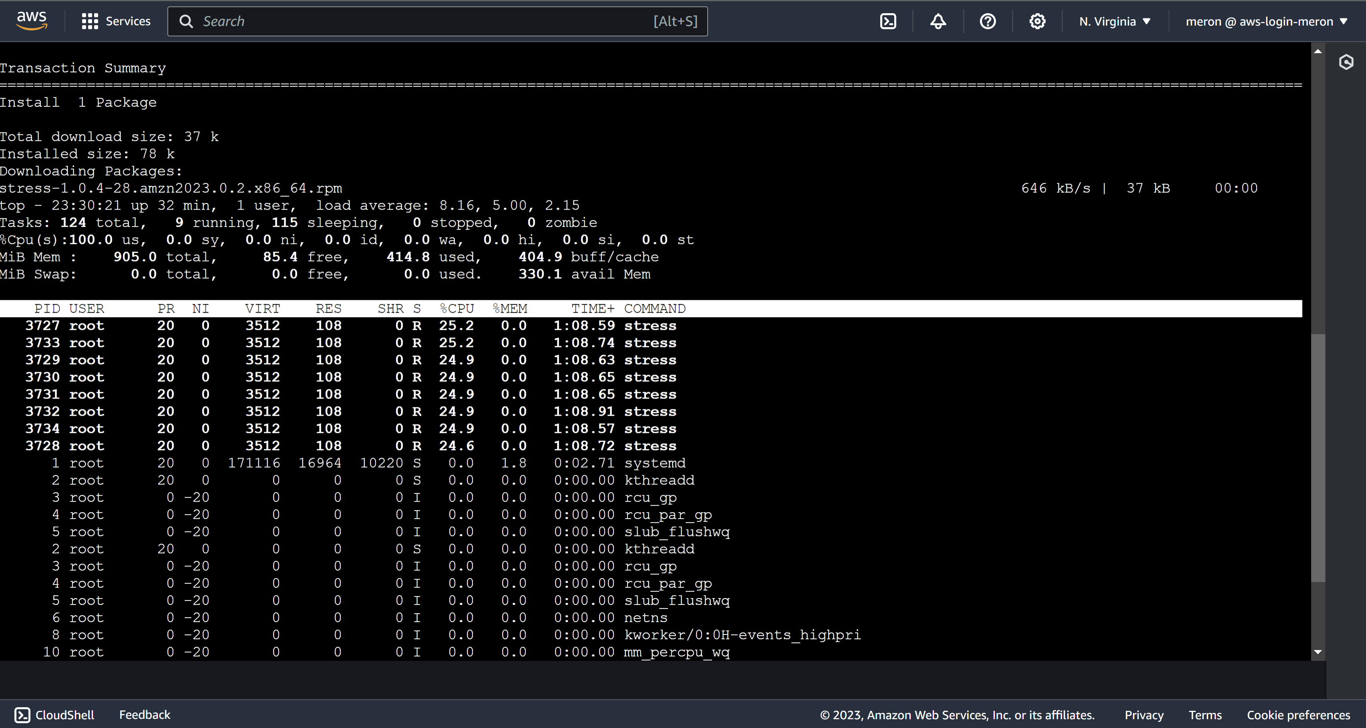
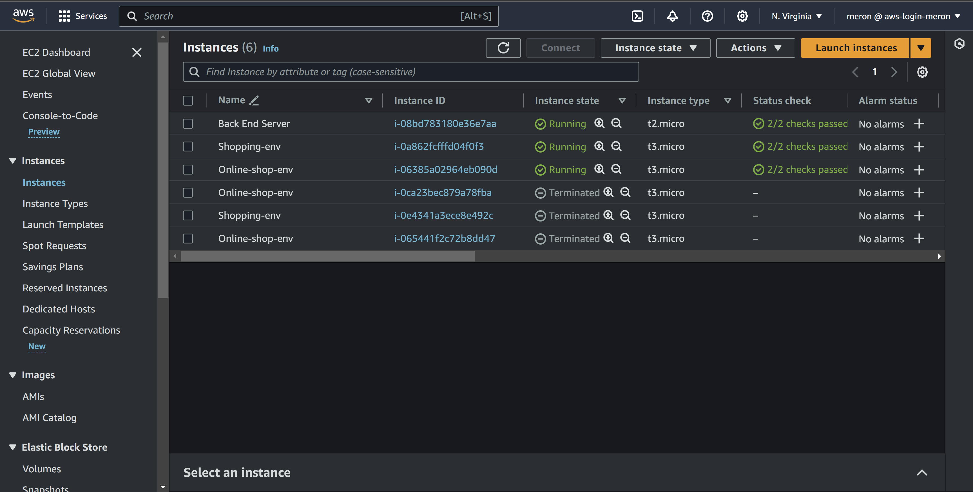
Beanstalk, Stress CPU for Load Balancing

Slide 20
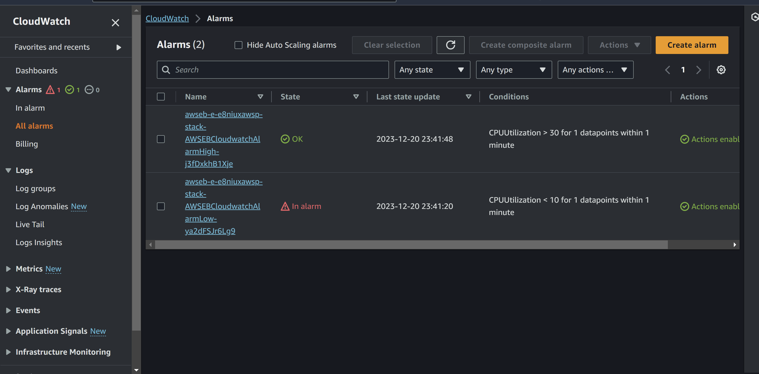
CloudWatch

Slide 21
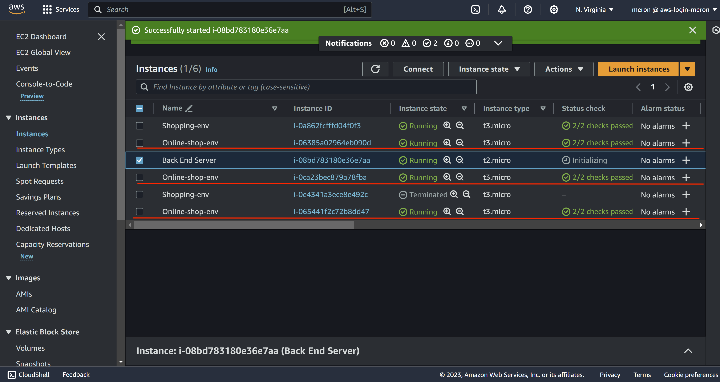
Beanstalk, Stress CPU for Load Balancing

Slide 22
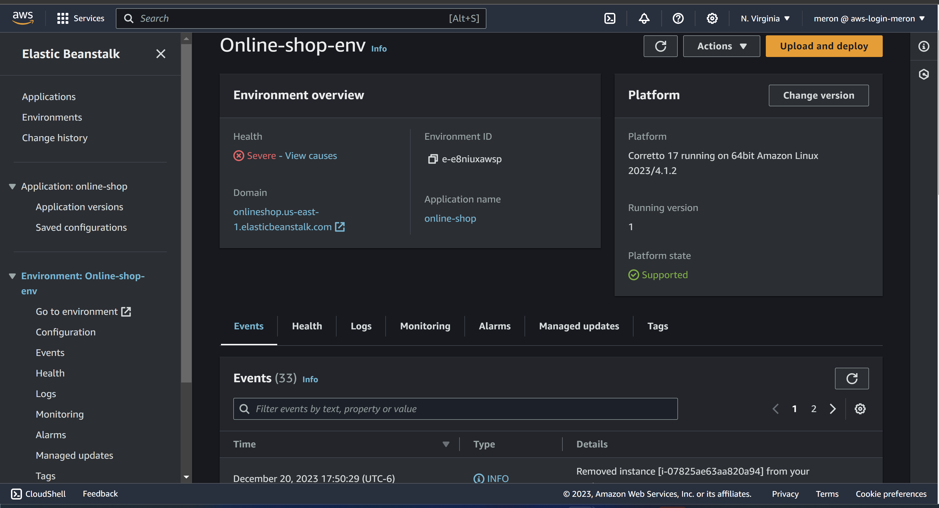
Beanstalk, Stress CPU for Load Balancing

Slide 23
AWS DocumentDB Database Connectivity
The connection between the Spring application and the private DocumentDB cluster for secure data management.

Slide 24
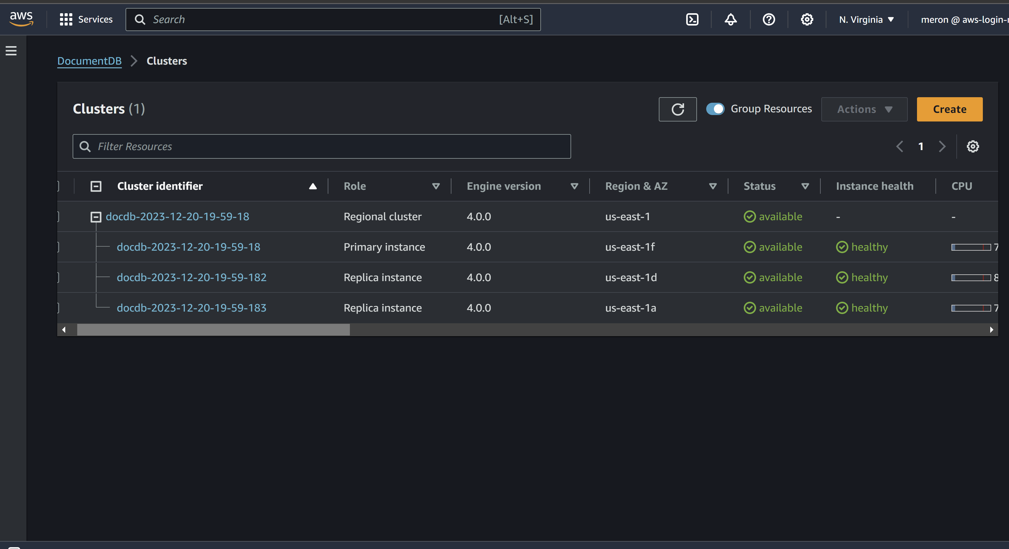
Document DB
is private

Slide 25
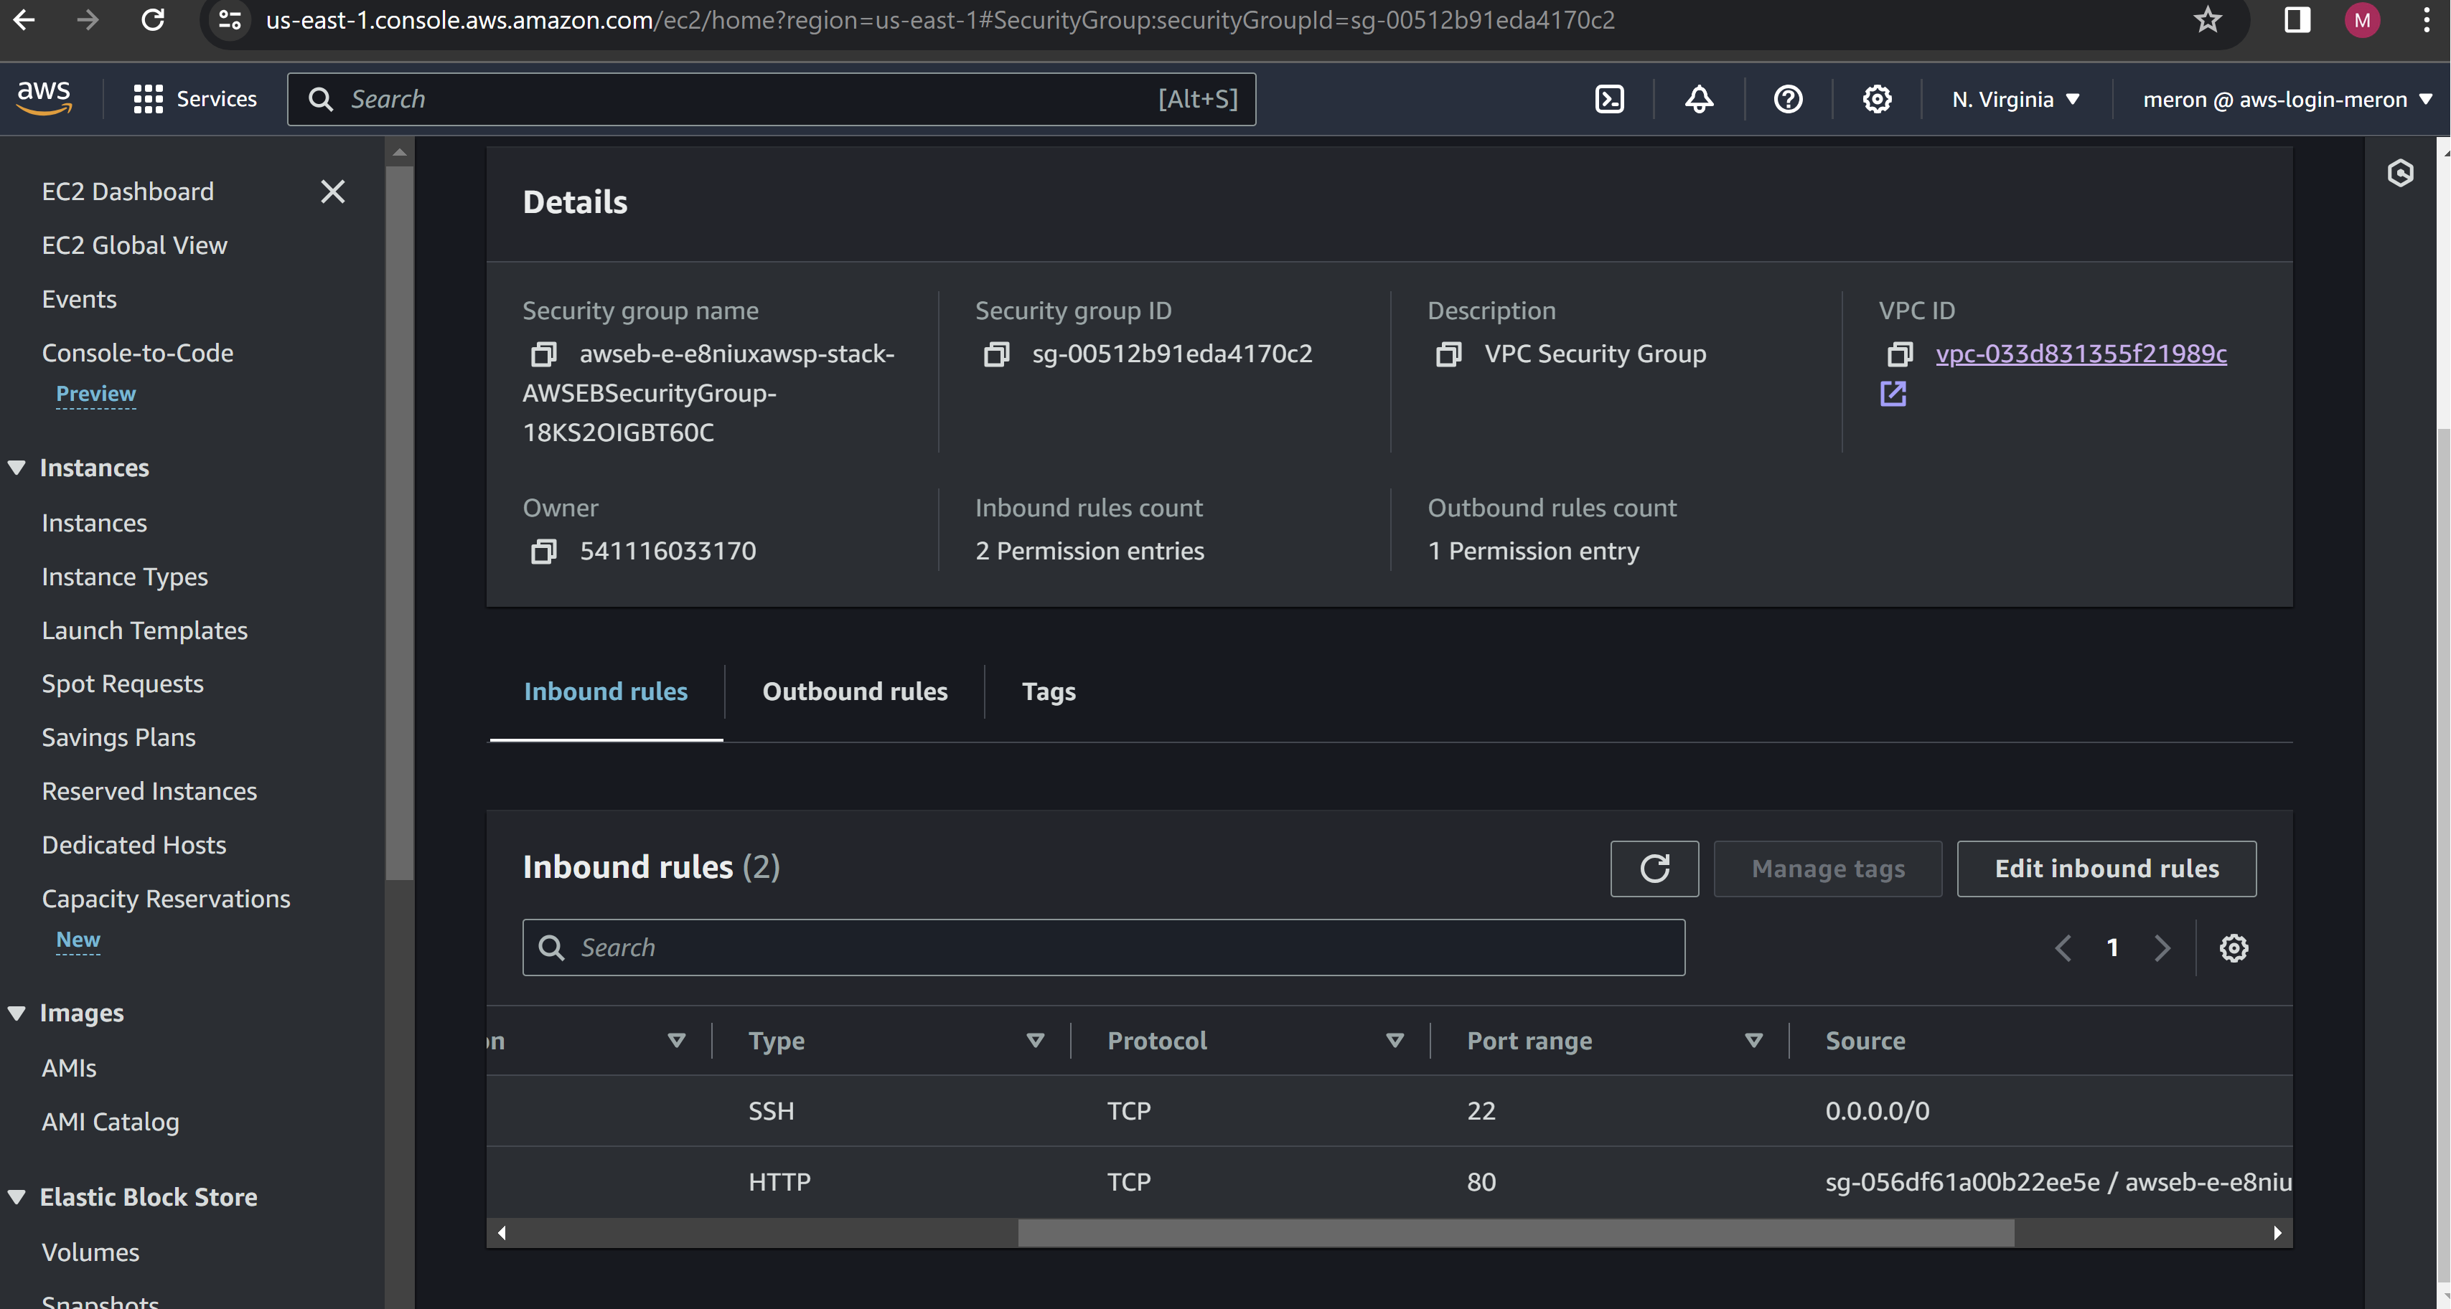
Document DB
is private

Slide 26
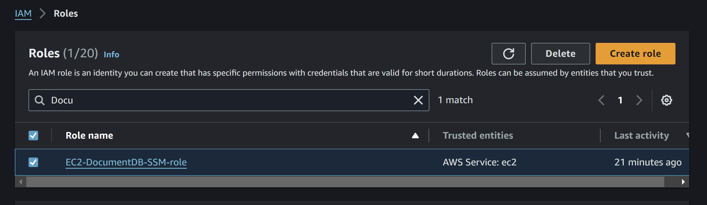
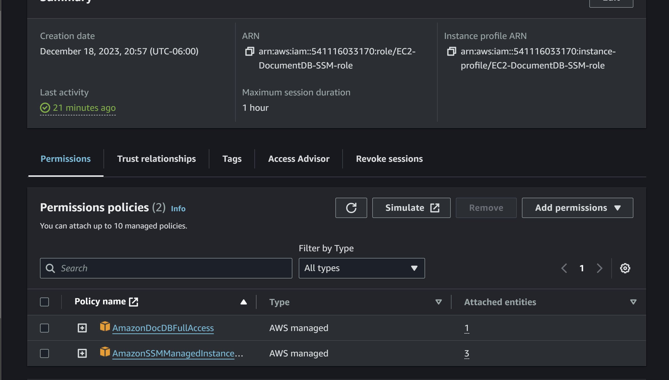
Document DB
is private

Slide 27
Conclusion
Summarizing the architecture's benefits for a scalable and efficient AWS application deployment.

Slide 28
Conclusion
Reliability and Fault Tolerance: Inherent resilience characterizes stateless architectures. Failure of a component doesn’t disrupt the system, as it can be replaced or restarted independently, ensuring continuous user sessions and enhancing system reliability.
Cost-Effectiveness: Architectures optimize resource use by dynamically adjusting to actual demand, preventing infrastructure overprovisioning. They align well with serverless computing, offering cost savings by charging only for actual runtime.
Performance: Utilizing services like S3&CloudFront for UI data can significantly reduce latency, offering faster access compared to internal session data management.

Slide 29
References
https://docs.aws.amazon.com/
https://aws.amazon.com/blogs/architecture/converting-stateful-application-to-stateless-using-aws-services/
https://aws.amazon.com/blogs/architecture/how-sonar-built-a-unified-api-on-aws/
https://docs.aws.amazon.com/apigateway/latest/developerguide/getting-started.html

Slide 30
Thank You

